Slide 1

LUNG CANCER IMAGING TOOL
MEDICAL IMAGING
2021
A tool For Medical Image Processing and Cancer Segmentation on Lung-CT images
Marco Peracchi 800578
Federico De Servi 812166

Slide 2

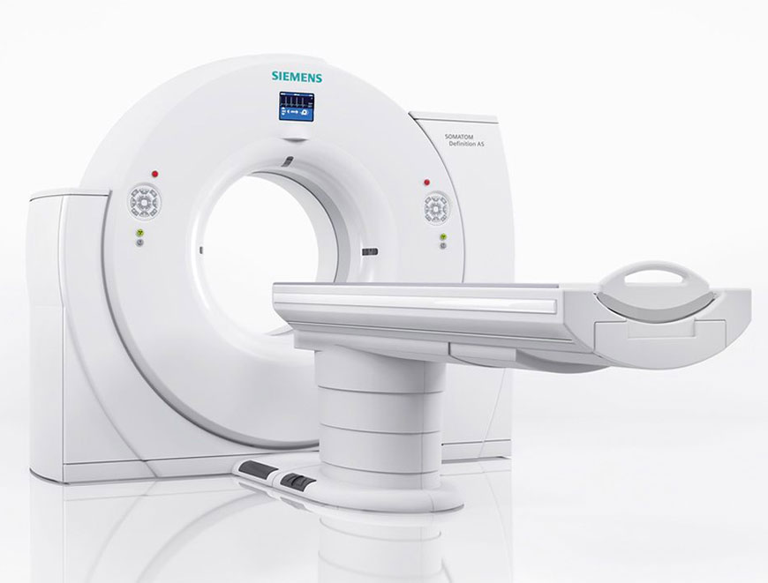
Topics
Introduction
Image Visualization Tool
Image Segmentation Tool
Clustering and Classification
Demo

Slide 3
INTRODUCTION

Slide 4


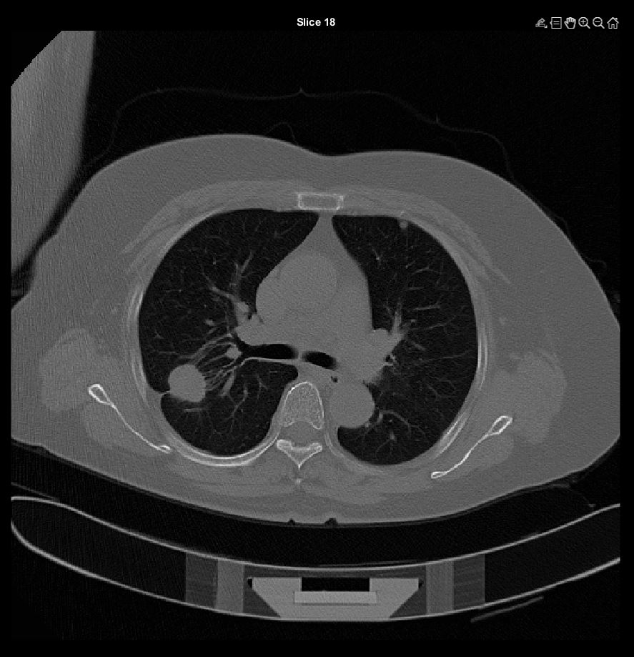
Lung cancer
Lung cancer is a lung tumor characterized by an uncontrolled cellular grown inside the primary organ of respiratory system. Lung cancer is by far the leading cause of cancer death among both men and women, making about 25% of all death due to cancer.

Slide 5



Dataset
Downloaded from Cancer Archive
Almost 8 Gb
Data of 23 patients
CT images
Keep only patients with 5 mm CT resolution [CONTROLLARE]

Slide 6


Patient CTs visualization
10 images overview
All images overview
Specific CT visualization
Segmentation Tool
Manual Segmentation
Ouputs volume and other relavant features
Clustering and classification
The tool: overview
The lung cancer imaging tool is oriented toward a visualization approach: CT images are showed to better visualize the abnormal tumoral mass, and all desired slices can be seen. Moreover tool asks user if he/she wants to perform manual segmentation image by image.
Finally, through the previous performed operation, different biomarkers are computed, including the volume. An unsupervised algorithm classifies patients in different groups.

Slide 7
Image visualization tool

Slide 8


CT Visualizations
9 imm , tot imm, singola

Slide 9
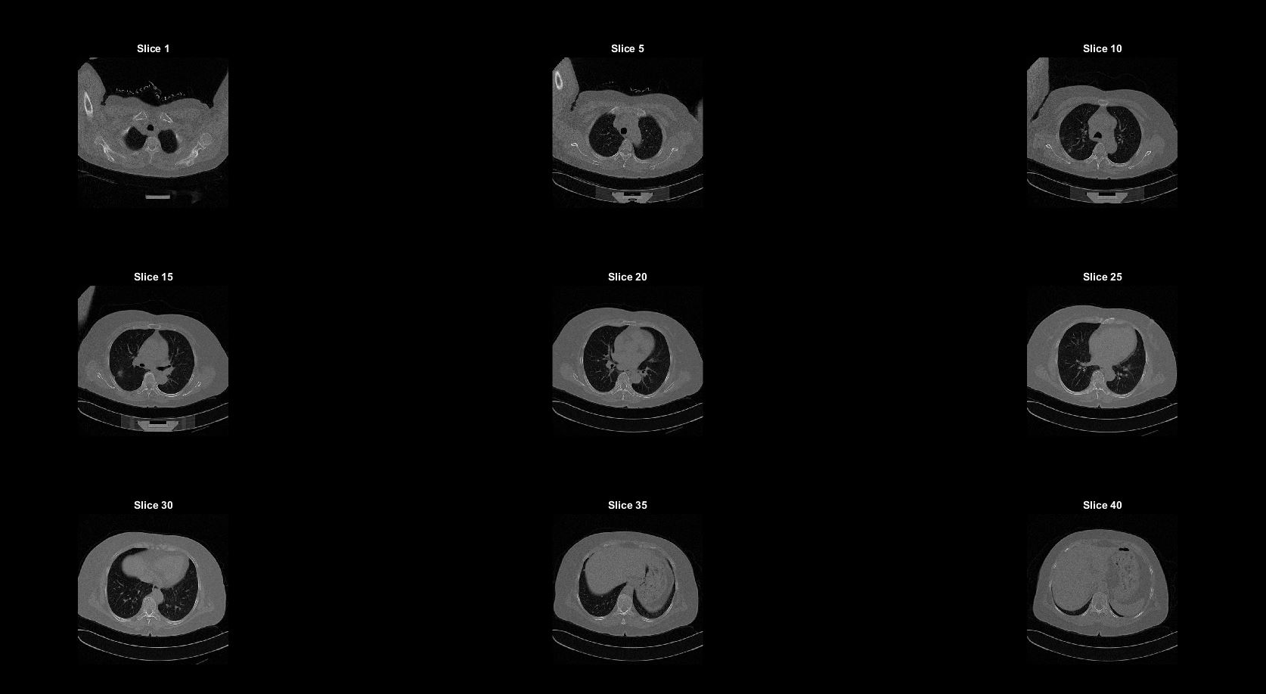
Results

Slide 10
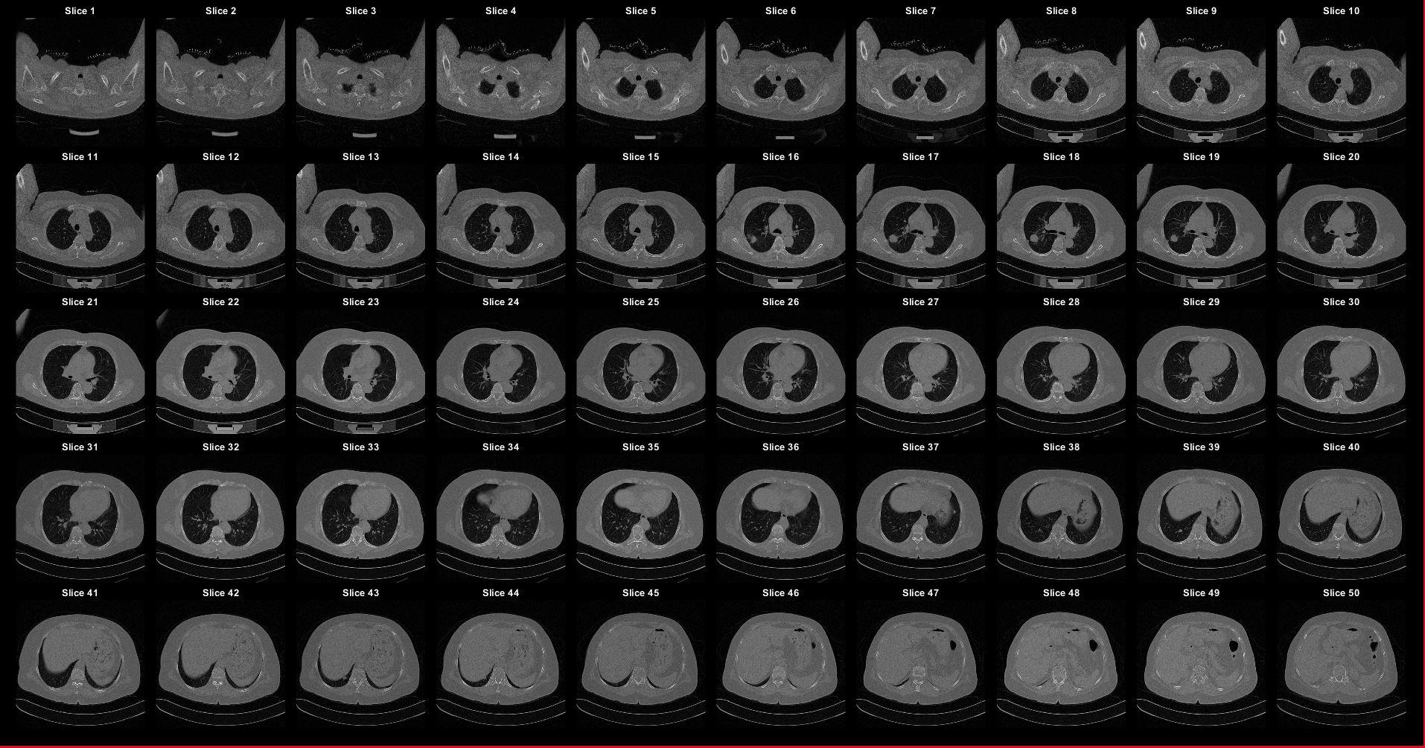
Results

Slide 11
Image SEGMENTATION tool

Slide 12

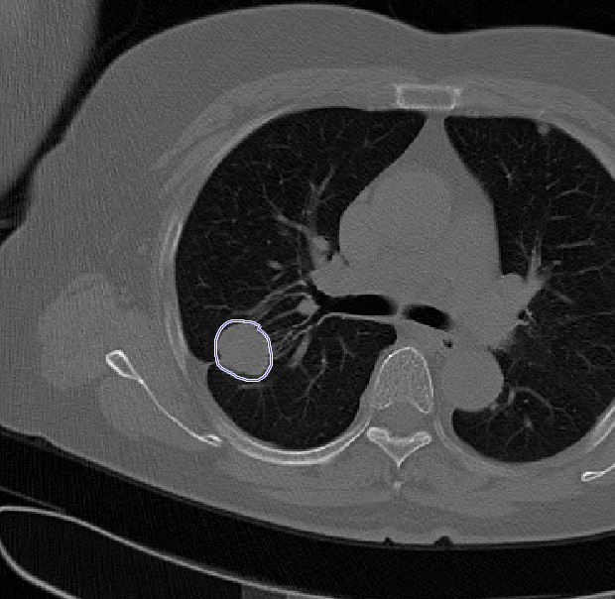
Cancer segmentation
Spiegazione tool

Slide 13
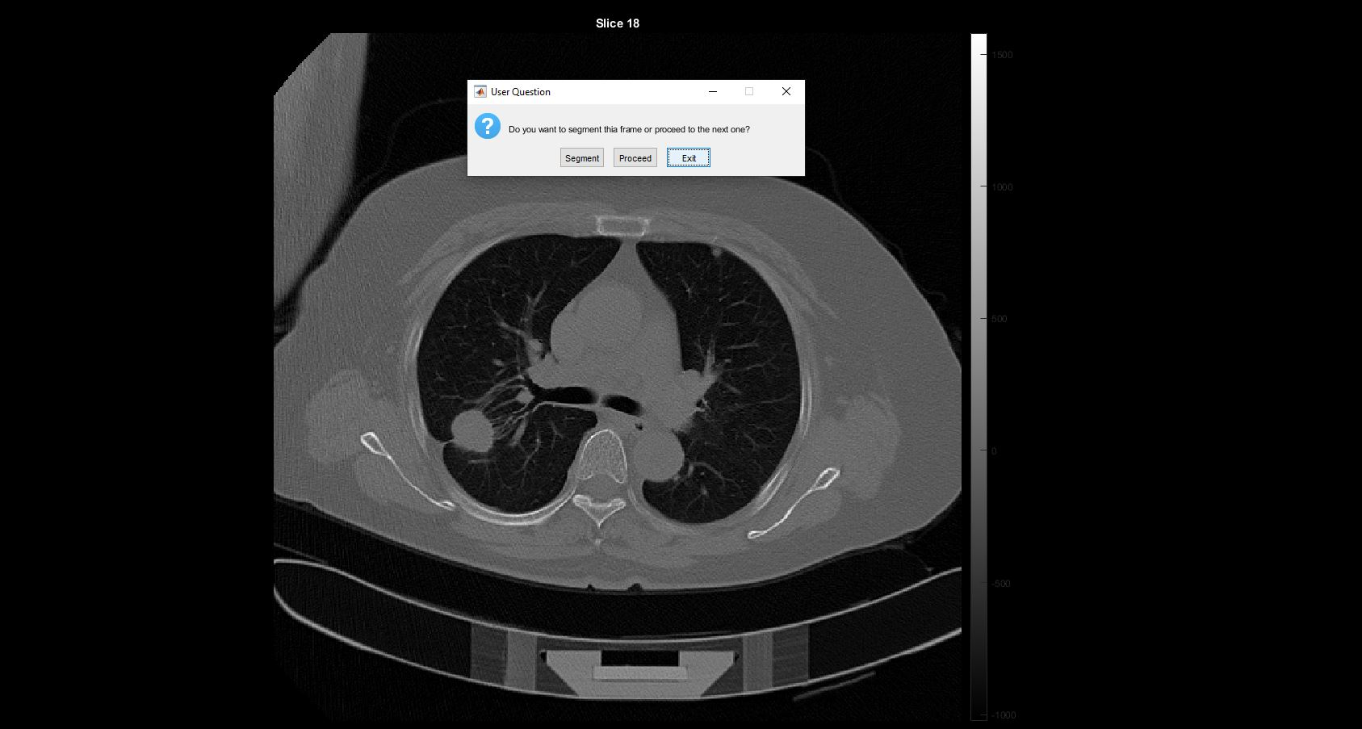
Results

Slide 14


Feature extraction
Features da estrarre

Slide 15
Results
sliceNum | volumes mm3 | areas | Rs | spherical_disproportions | sphericities | surfacevolume__ratios
16 | 451,578331 | 8,218227386 | 4,759355675 | 0,028871674 | 34,63602415 | 0,018198897
17 | 1140,829468 | 26,55687256 | 6,48202508 | 0,050297413 | 19,8817381 | 0,023278565
18 | 1250,158958 | 24,6500499 | 6,682806341 | 0,043922817 | 22,76721 | 0,019717533
19 | 722,5253296 | 20,47115601 | 5,566576167 | 0,052572205 | 19,02145822 | 0,028332787
20 | 2,376728058 | 0,147397537 | 0,827872827 | 0,017114062 | 58,43148082 | 0,062016997

Slide 16
CLUSTERING AND CLASSIFICATION

Slide 17
Clustering and classification
The objective is to train a CNN model in order to classify correctly the biggest number of audio containing sounds of animals. These sounds have a lenght that ranges from 2 to 3.5 seconds and different levels of background noise.

Slide 18
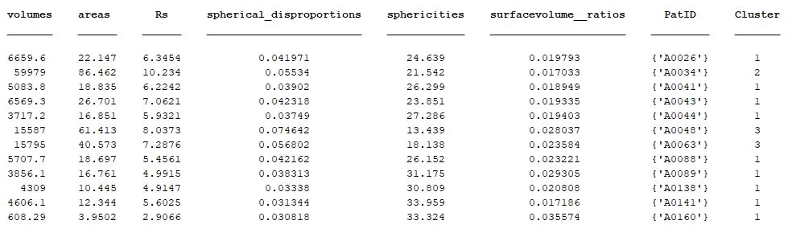
Results
Clustering

Slide 19
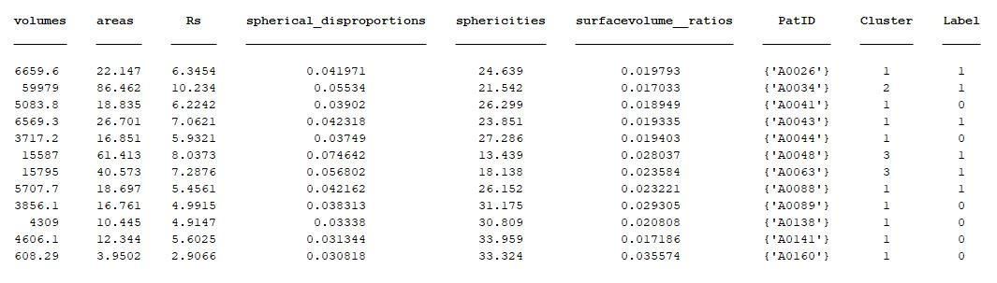
Results
Classification

Slide 20
DEMO

Slide 21

Demo

Slide 22

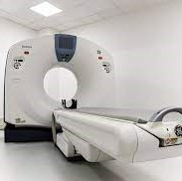

THANK YOU
Marco Peracchi- 800578
Federico De Servi - 812166

